Slide 1
House pricing prediction -Prachi PArmar

Slide 2
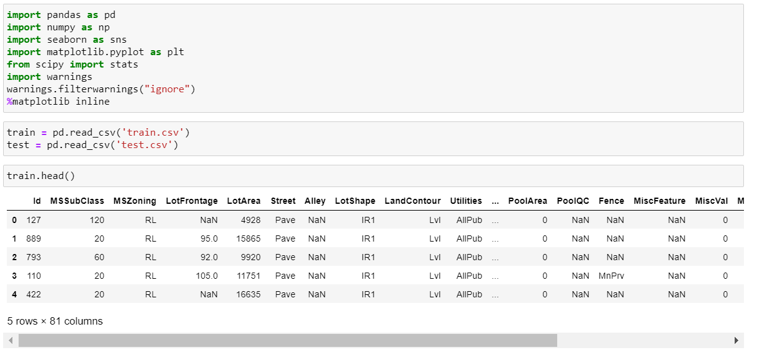
Importing the libraries and loading the data

Slide 3
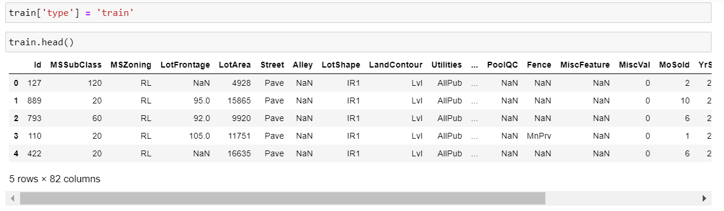
The above picture shows the training data. And we will also add a column named type which will segregate them as train or test data when we merge train and test.

Slide 4
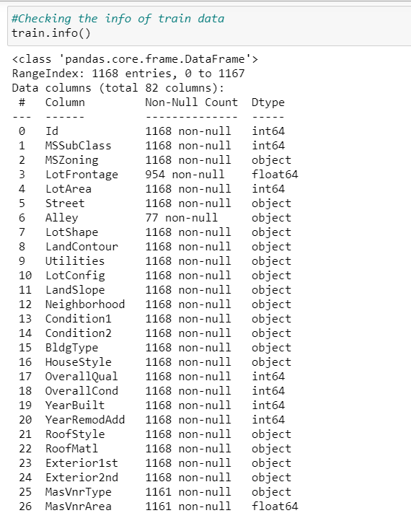
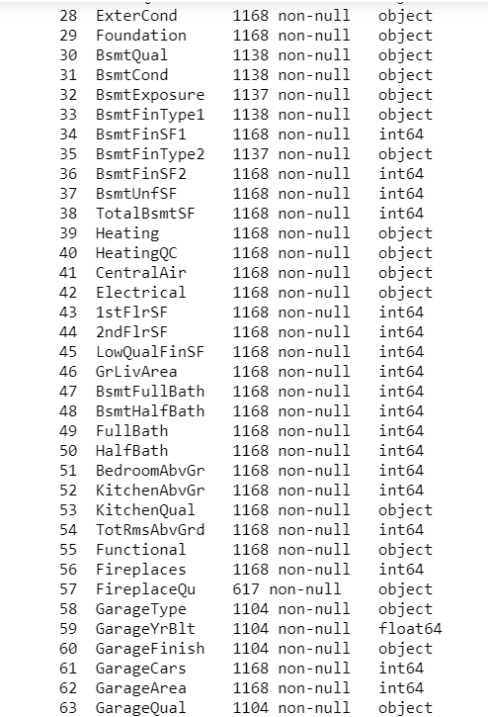
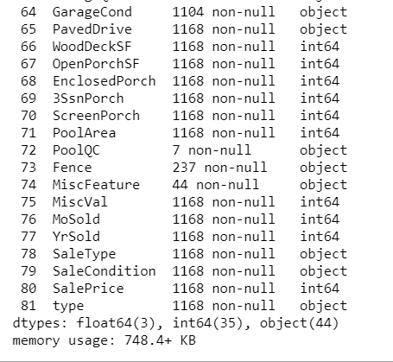
We can see that we have a total of 81 columns and 1168 rows in our training dataset. Also we have few columns which are having null values too.

Slide 5
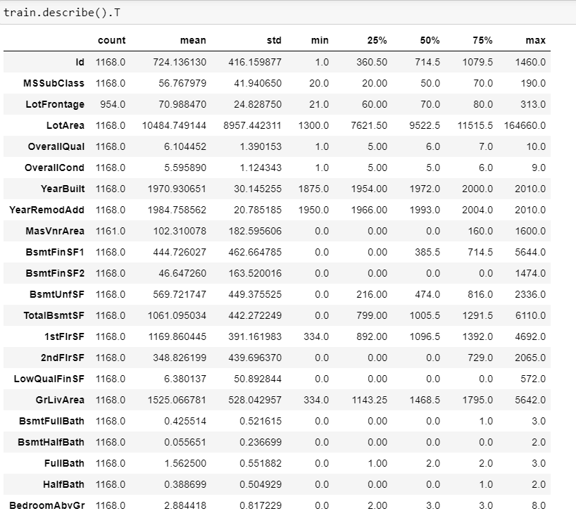
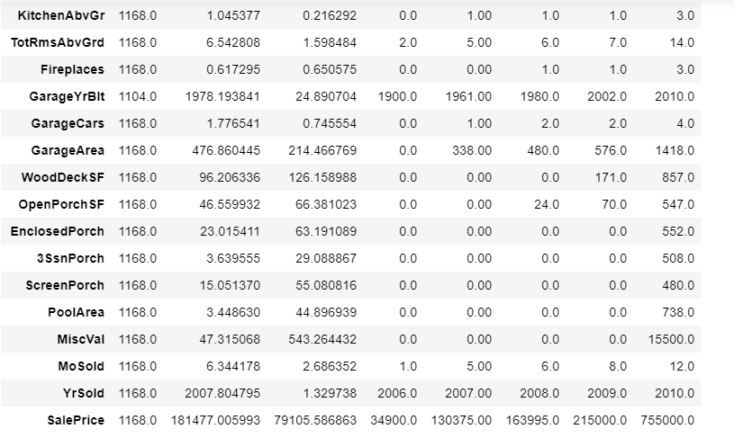
So, these are our numerical columns and we can see that few of the column are not normally distributed. So we will have to take care of that too.

Slide 6
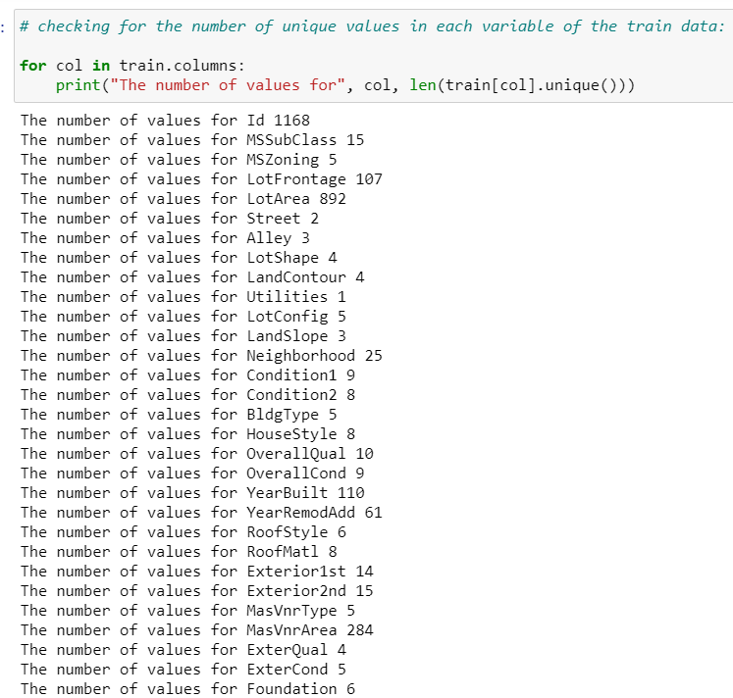
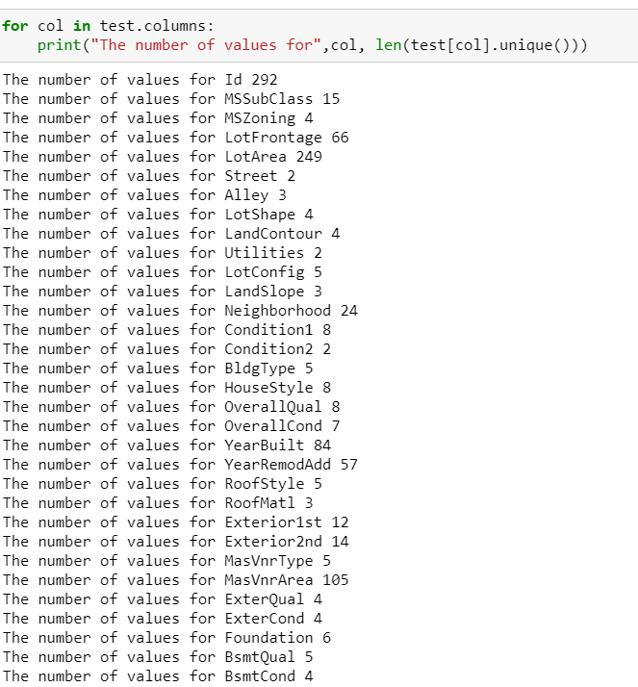
Let’s have a look on how many unique values we have in our columns. I am showing only few columns here as we have 81 columns all total. Left one is for training and right one is for testing.

Slide 7
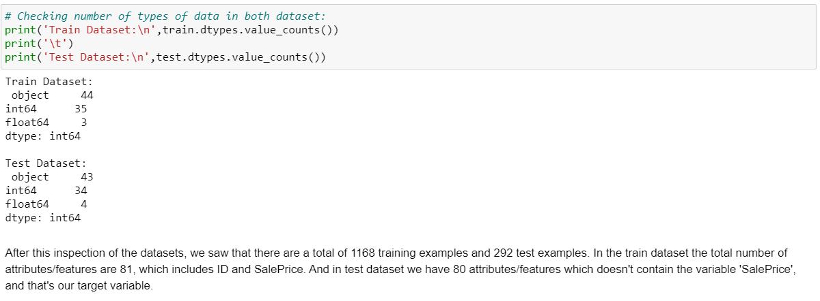
After inspecting both the datasets we saw that we have 1168 training examples and 292 in test examples. In training data we have 81 attributes and in test data we have 80 attributes which doesn’t have Sale price column. And that is our target variable

Slide 8
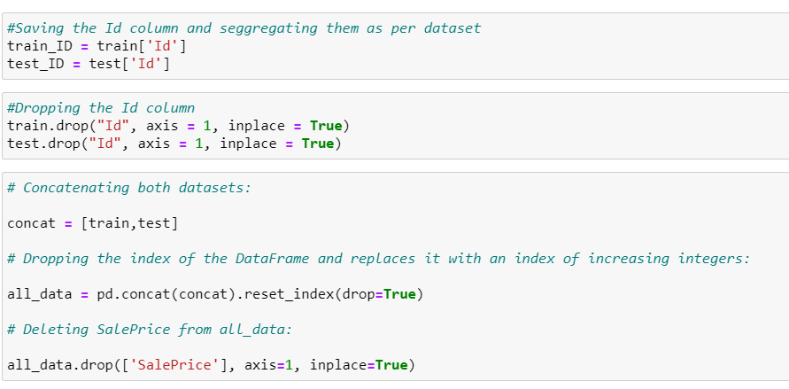
Concatenating both the dataset as all_data and dropping the Saleprice.

Slide 9
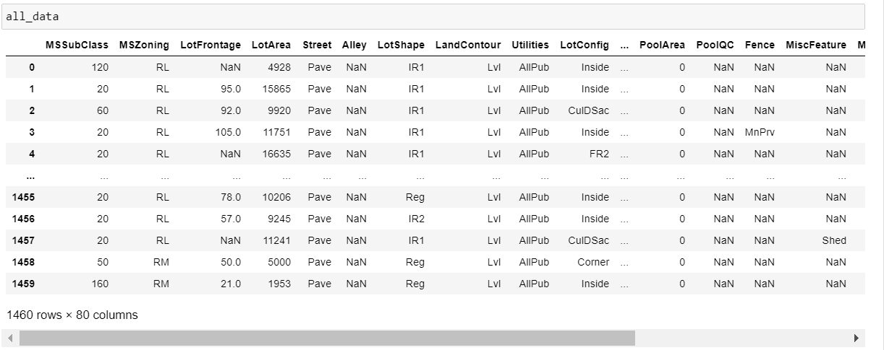
So, now we have a total of 1460 rows and 80 columns

Slide 10
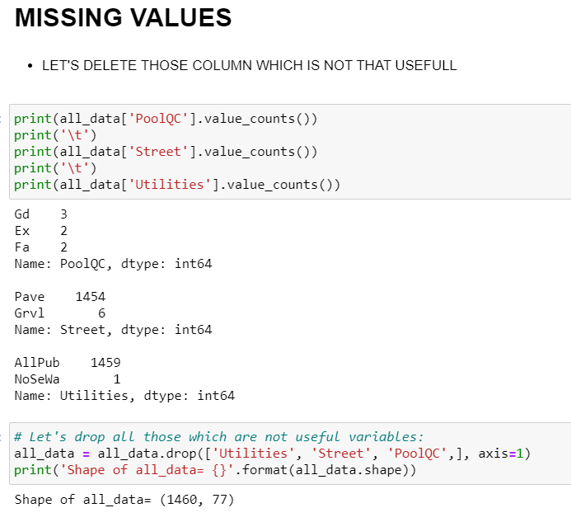
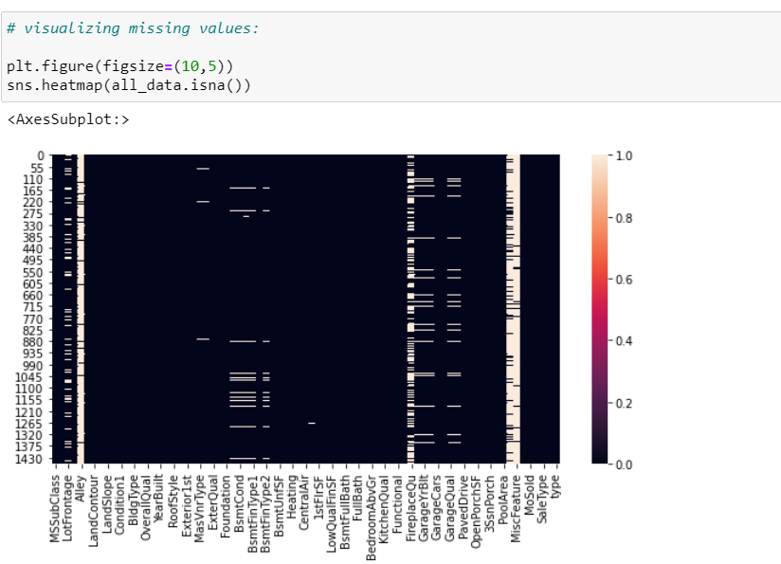
We will now do the data cleaning and we will make the data ready for modelling

Slide 11
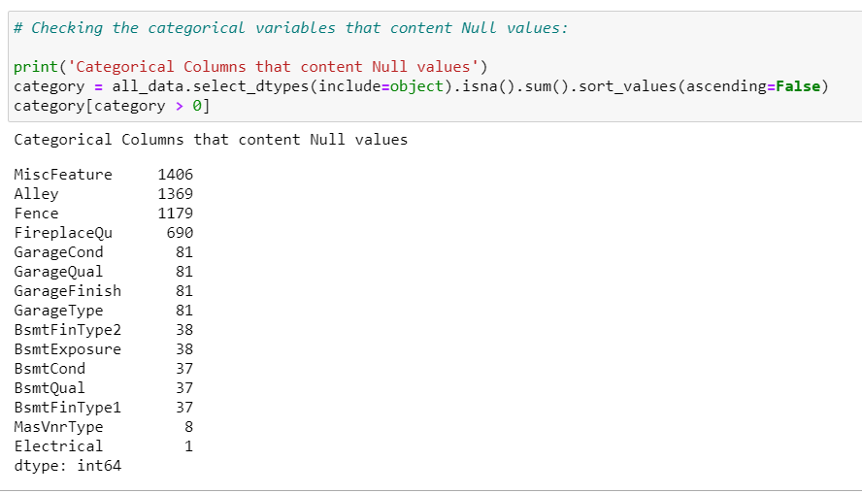
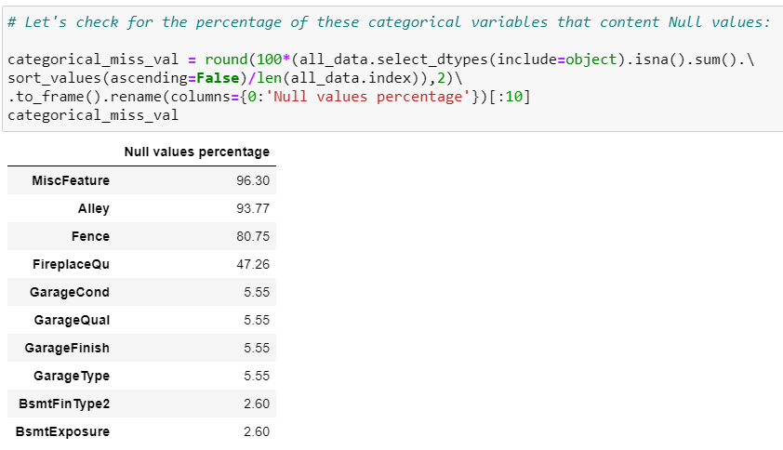
In the above picture we can see that the quantity of null values in categorical columns

Slide 12
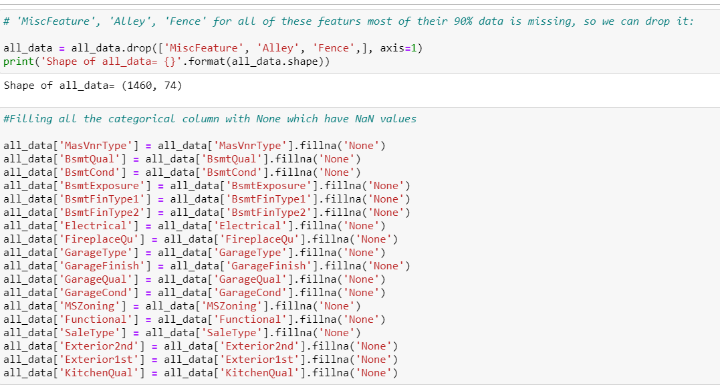
Dropping the columns which have most of the values as null. And replacing the other null values of categorical columns with None.

Slide 13
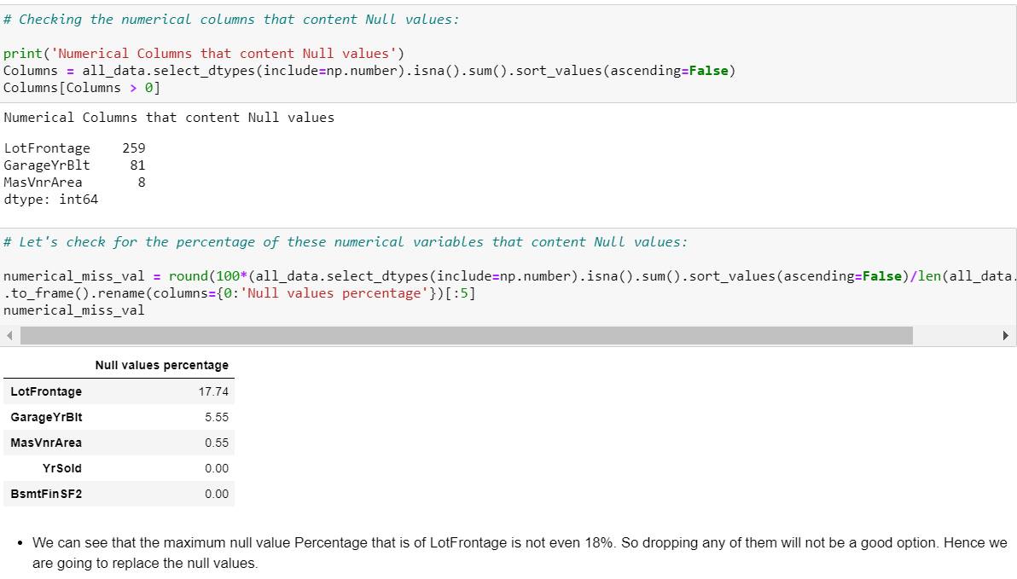
As we don’t have much null values in Numerical columns we will replace the null values with median

Slide 14
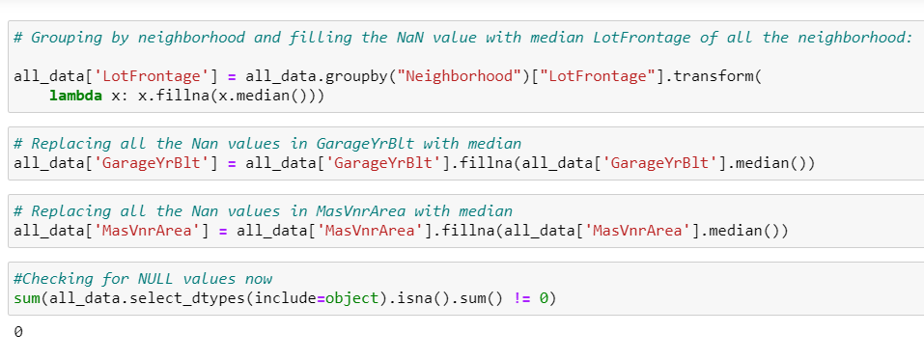
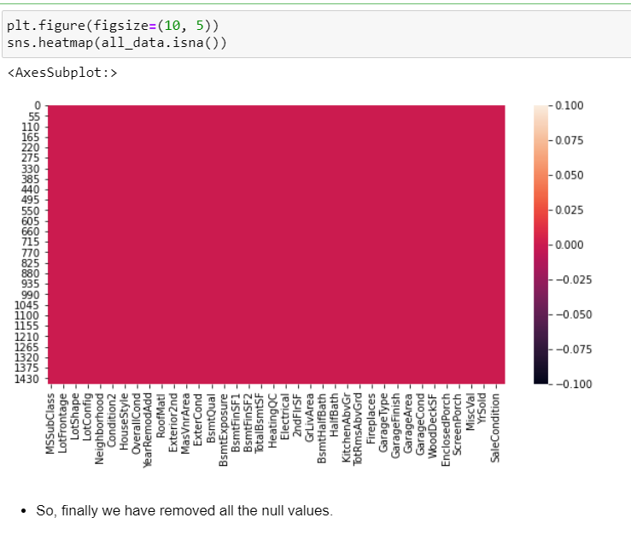
Replaced the null values in both the numerical and categorical column. We can see that now we don’t have any null values in the dataset

Slide 15
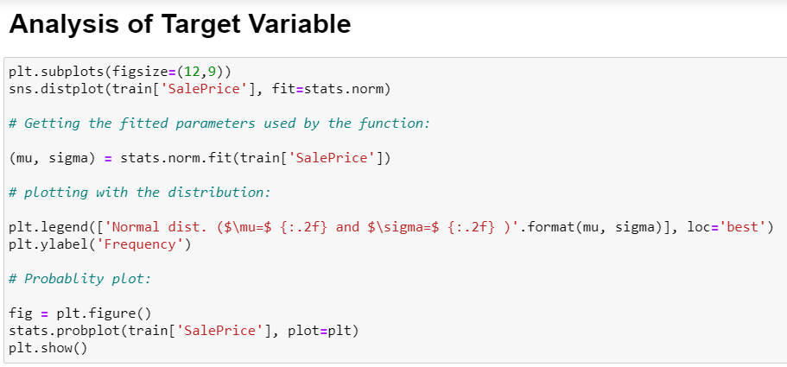
Analysing the Target Variable

Slide 16
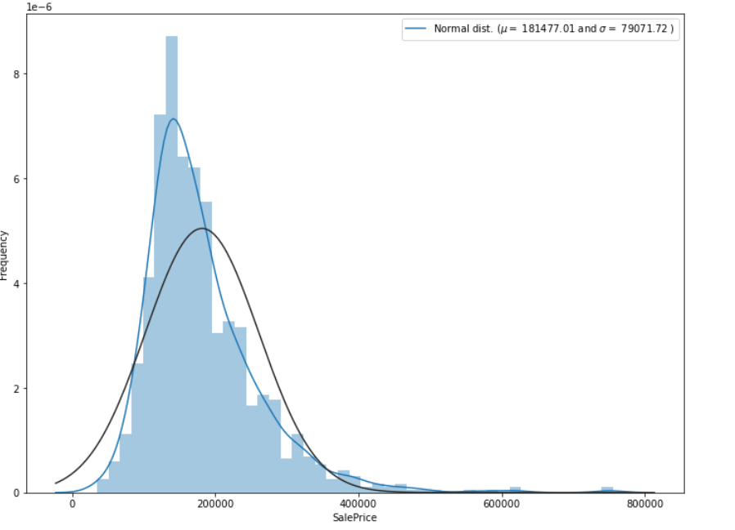
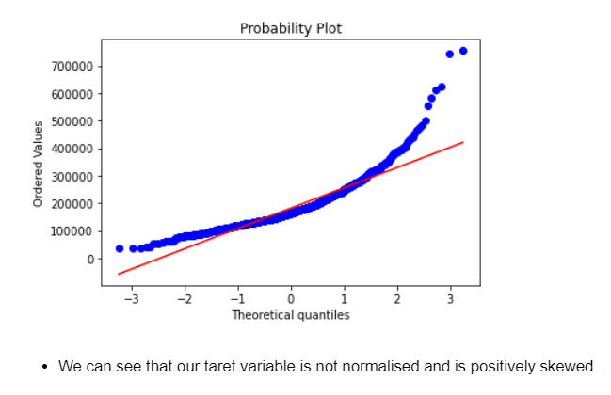
From the graph we can see that the target variable is not normalised and is positively skewed. This will create problem in model building. We will normalise the data

Slide 17
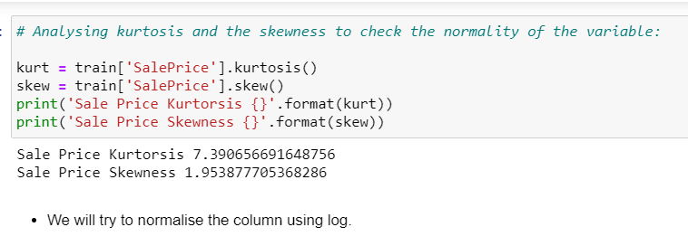
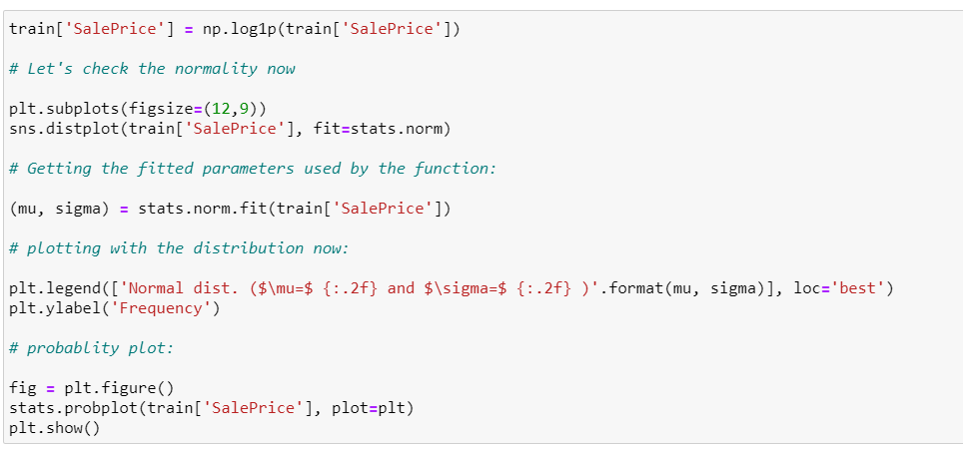
Normalizing the data

Slide 18
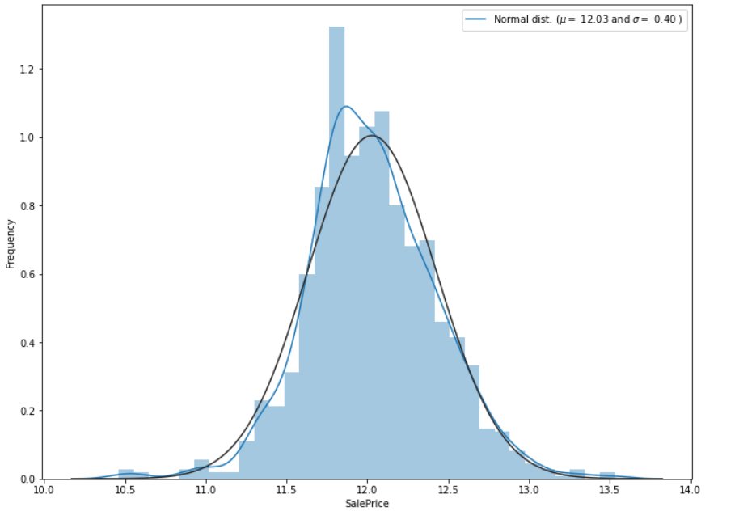
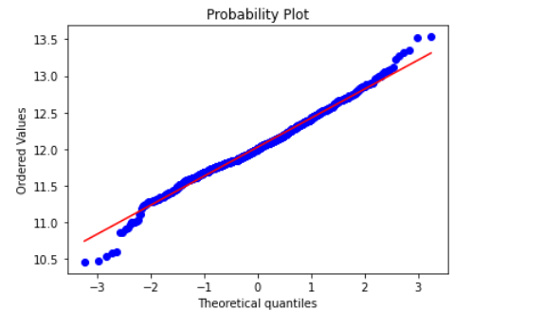
I have used logarithmic method to make the data normalised.

Slide 19
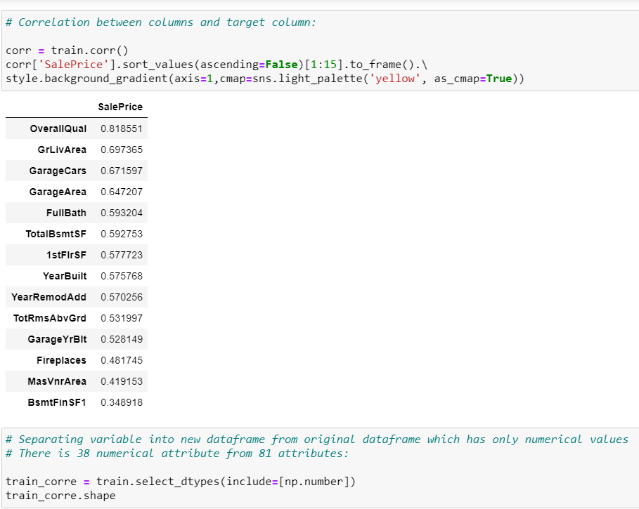
Let’s see which all column have more correlation towards the target variable.

Slide 20
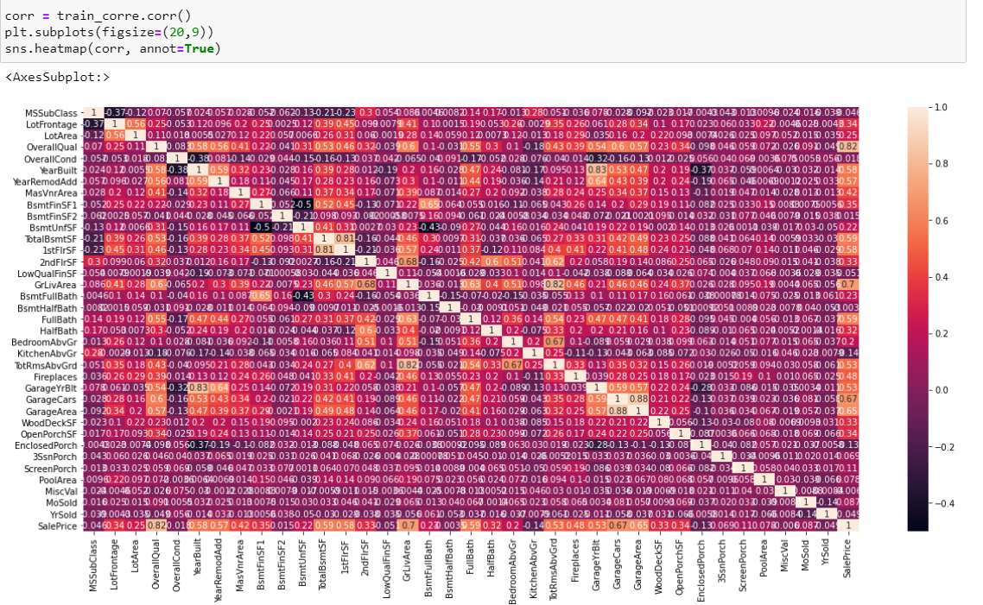
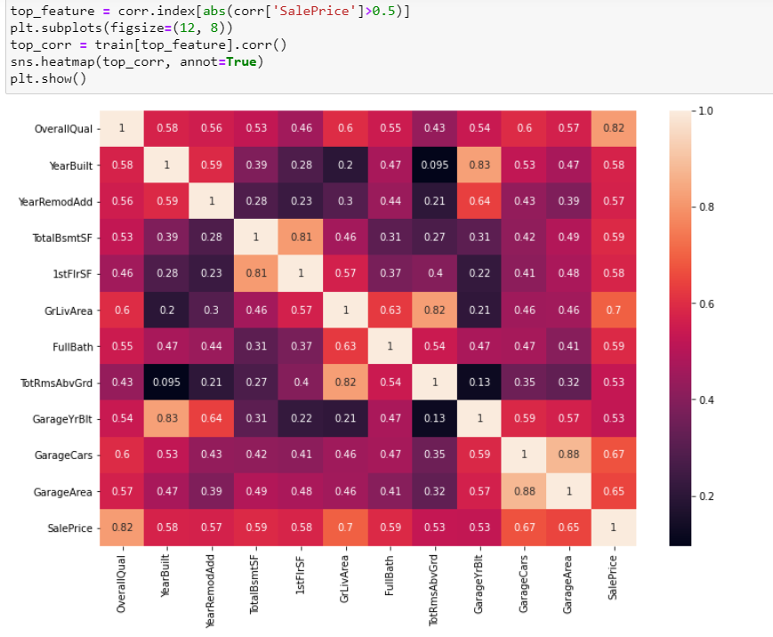
In the right side we have the names of the column which are highly correlated with the target variables.

Slide 21
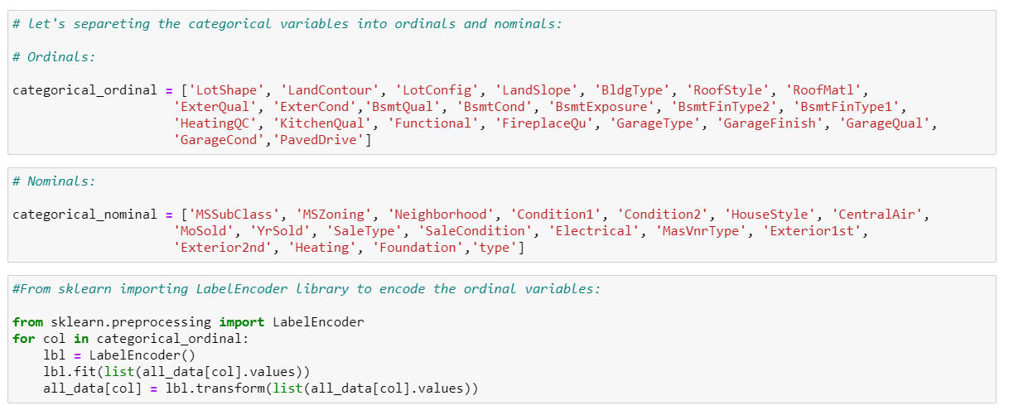
Separating the categorical column into ordinal and nominal data.

Slide 22
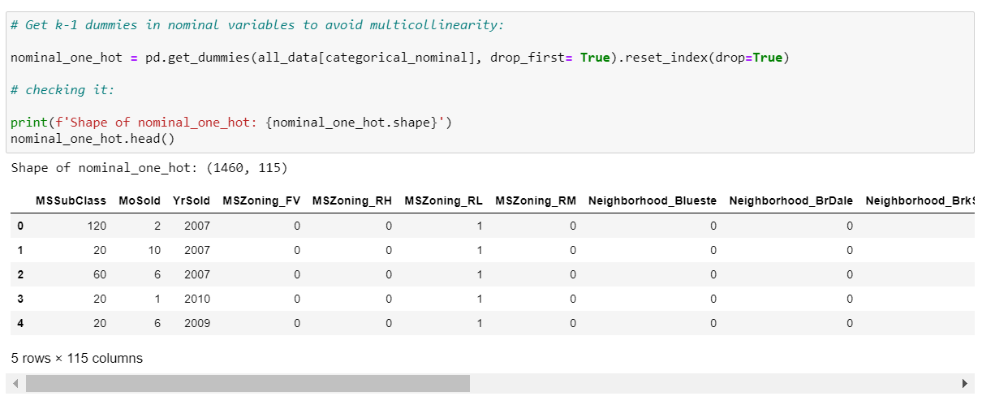
Label Encoding and One hot encoding

Slide 23
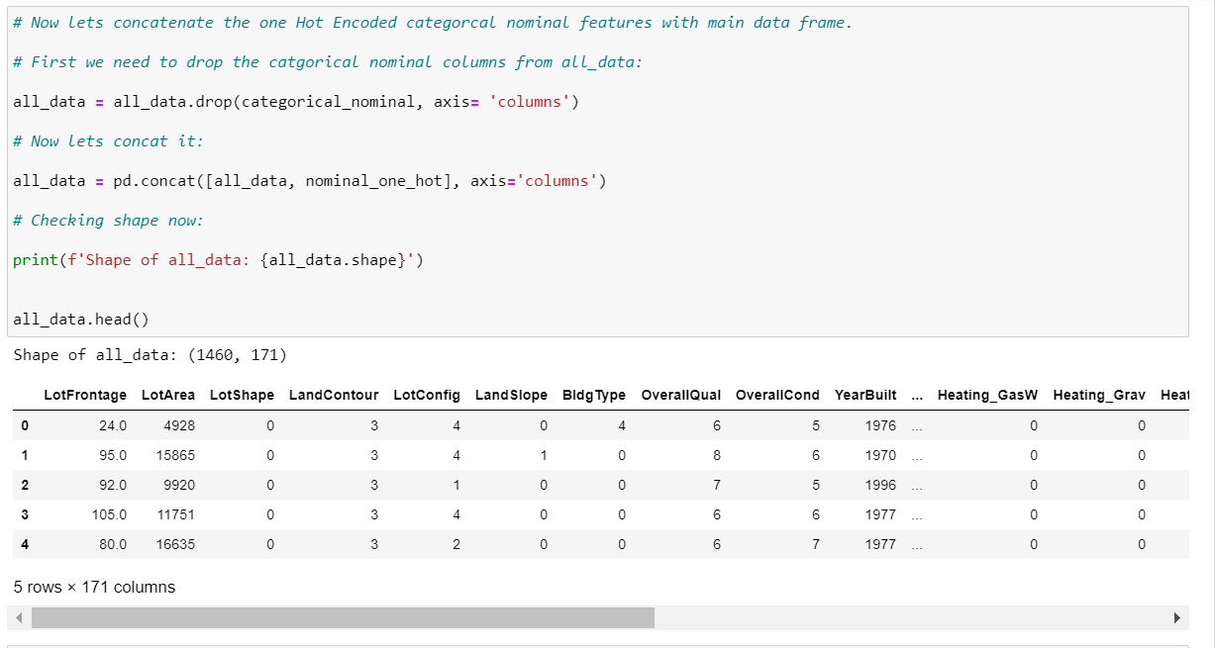
So, this is how our final data looks like.

Slide 24
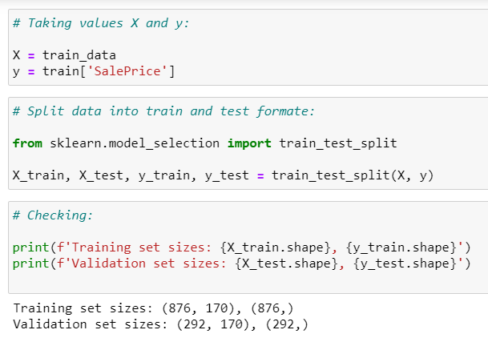
Model Building:

Slide 25
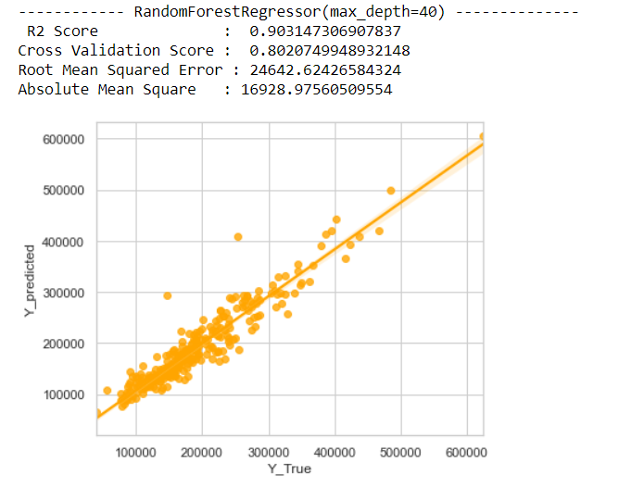
I am using random forest regressor with 90% r2score.

Slide 26
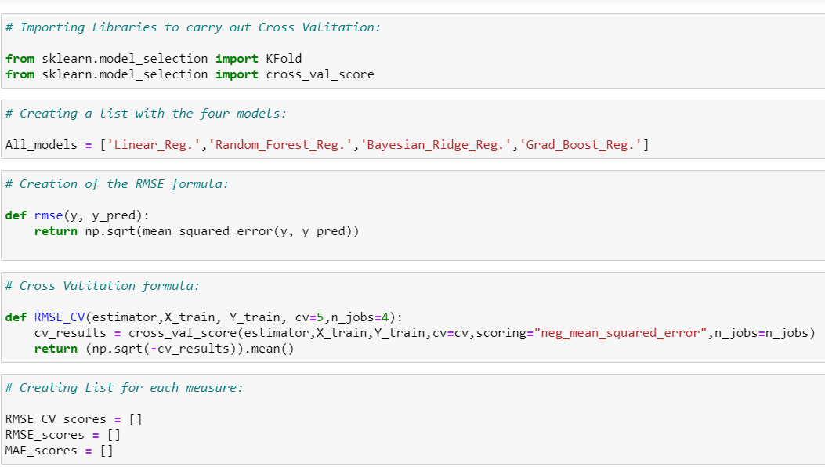
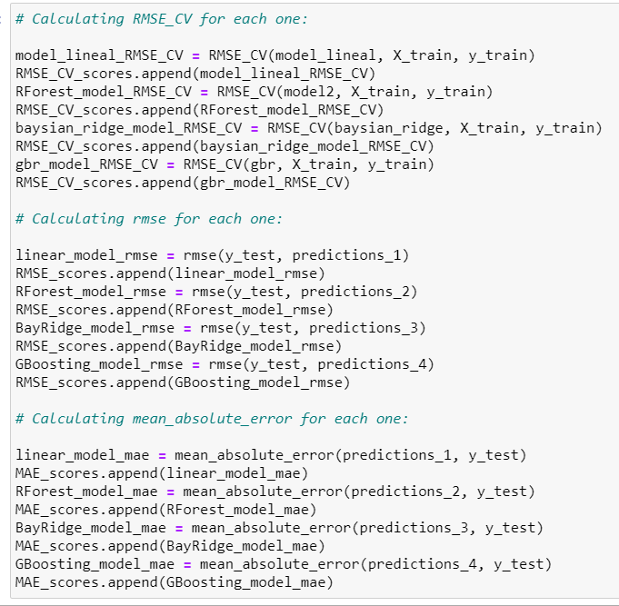
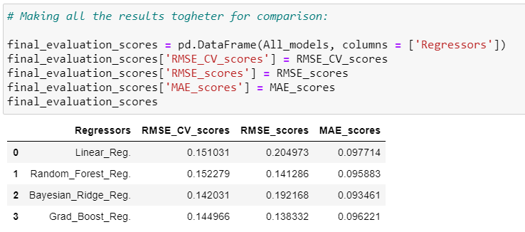
Cross validating our all the models to confirm our models are not overfitting. We can see the performance of all the models on the right side.

Slide 27
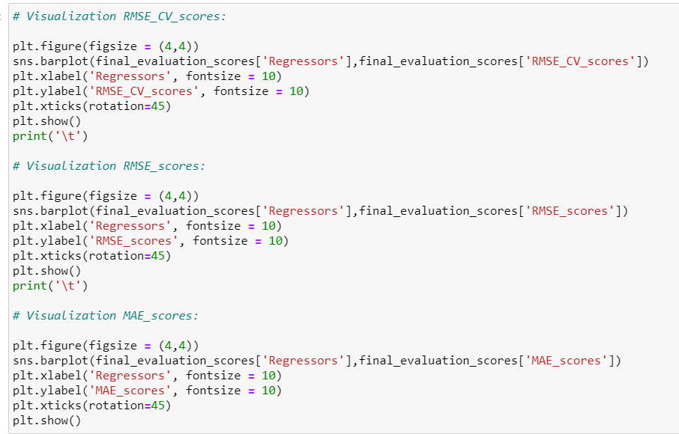
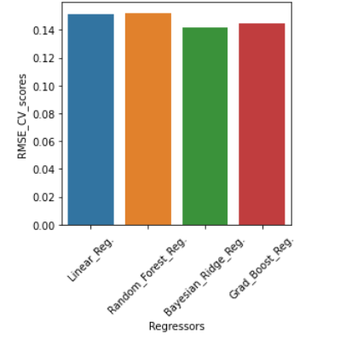
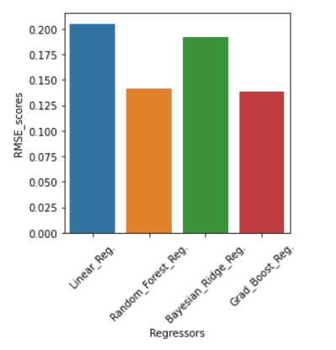
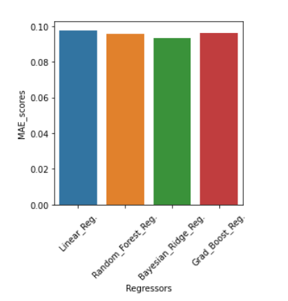
Visualising the performance of all the regressor we used. It’s pretty clear that the Gradient Boost Regressor is performing the best out of all.

Slide 28
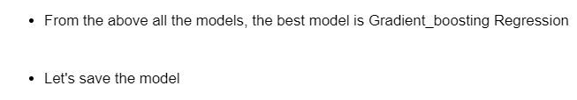
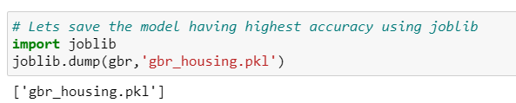
Let’s save our best performing model for the prediction.
Thank you

